Slide 1
INTRODUCTION TO HRM

Slide 2
Human resource management
HRM is a strategic approach to the acquisition, motivation, development and management of the organisation’s human resources.
According to Decenzo and Robbins, “HRM is concerned with the people dimension” in management.
The most important asset of the organization is its employees, so the prime responsibility of management is to manage human resource in effective manner.
The basic function of management is to bring employees and organization on the same platform in order to meet the individual goals as well as organizational goals at the same time.

Slide 3
The organisation, whether private or public, is seen in a new light in that it is now considered as a group of human beings who coordinate their activities to reach specific goals. In other words, the organisational system no longer depends on a single person, the one in charge, but on all the staff and their will, motivation and comprehension of the goals to be reached.

Slide 4
HRM is the study of activates regarding people working in an organization. It is a managerial function that tries to match an organization’s needs to the skills and abilities of its employees. Let’s see what is meant by the three key terms… human, resource, and management.

Slide 5
Human: refers to the skilled workforce in an organization.
Resource: refers to the source that is used to get finished good or service.
Management: refers how to optimize and make best use of such limited or scarce resource so as to meet the organization goals and objectives.

Slide 6
Definition:
Pigors and Myers – “It is basically a method of developing potentialities of employees so that they feel maximum satisfaction of their work and give their best efforts to the organization”.
Byars and Rue – “Human resource management encompasses those activities designed to provide for and coordinate the human resources of an organization Human resource functions refer to those tasks and duties performed in organizations to provide for and coordinate human resources”.

Slide 7
History of HRM
Human resource management is evolved from the Personnel management which was previous management system which used to manage employees. Elton Mayo who was a psychologists from the Australia, did many experiments on human behaviour at different situations in 1924. He strongly believed in work life balance for improving productivity of workers and did emphasis on human relations influence the productivity of workers and finally he has been regarded as father of Human resources management.
Main principle of the Personnel management was to extract work from an employee for the remuneration paid. Employees during the Personnel management era were not given high priority in decision making process and weren't much allowed to interact with management.

Slide 8
History of HRM:
Main principle of the Human resource management is to see what should be given to an employee for extracting the desired work.
It is an employee right to not to work more than 9 hours in any day or 48 hours in any week in the factory. There should be interval or break for rest for at least 30 minutes after five hours continuous work of an employee according to The Factories Act 1948. The same right is applicable to the employees working in the shops and establishments like hotels, movie theatres and amusement and entertainment establishments according to the concerned state shops and Establishment act.

Slide 9
Rights of an employee
Weekly holiday
Salary or wages
Payment for overtime working
Payment of gratuity
Payment of bonus
Maternity leave
Compensation in case of accidents, injuries and death of an employee
Protection against harassment at workplace

Slide 10
Objectives of HR Manager are:
1. To create and maintain good relations amongst all those working in the organisation.
2. To bring about efficient utilisation of the available human resources in the organisation.
3. To provide justice to the employees in the form of good working conditions and attractive pays along with good promotional avenues.
4. To perform the necessary managerial relating to human resources.

Slide 11
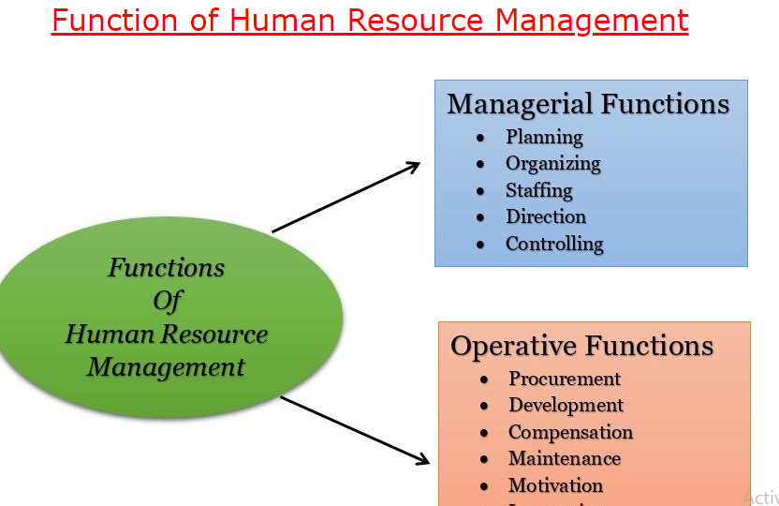

Slide 12
HUMAN RESOURCE FUNCTIONS
The major functional areas in human resource management are: (1) planning, (2) staffing, (3) employee development, and (4) employee maintenance. These four areas and their related functions share the common objective of an adequate number of competent employees with the skills, abilities, knowledge, and experience needed for further organisational goals. Although each human resource function can be assigned to one of the four areas of personnel responsibility, some functions serve a variety of purposes. For example, performance appraisal measures serve to stimulate and guide employee development as well as salary administration purposes. The compensation function facilitates retention of employees and also serves to attract potential employees to the organisation.

Slide 13
Why are we concerned with HRM?
Helps you get results - through others.
Different managerial techniques help mangers to direct the performance of employees in desirable direction in order to achieve the organizational objectives. Through the efforts of others working in an organization, managers get things done that require effective human resource management.

Slide 14
Helps you avoid common personnel mistakes
Qualified HR mangers utilize organization resources in such a way that helps to avoid common personnel mistakes like the following…
a. Hiring the wrong person for the job
b. Experiencing high turnover
c. Finding employees not doing their best
d. Having your company taken to court because of your discriminatory actions

Slide 15
e. Having your company cited under federal occupational safety laws for unsafe practices
f. Allowing a lack of training to undermine your department’s effectiveness
g. Committing any unfair labor practices

Slide 16
Helps you to gain Competitive Advantage
Among all the resources possessed by the organizations it is only Manpower or the Human resources that create the real difference. Because all organizations can have the same technology, they can possess same type of financial resources, same sort of raw material can be used to produce the goods and services but the organizational source that can really create the difference is work force of the organization. Therefore they are the main sources of innovation creativity in the organizations that can be used as a competitive

Slide 17
advantage. In today’s competitive environment, these are the people which can create competitive advantageous for the organizations.
The world around us is changing. No longer can we consider our share of the “good Life” given. If we are to maintain some semblance of that life, we as individual, as organizations, as society will have to fight actively for it an increasingly competitive global environment.

Slide 18
Challenges/Issues of Managing Human Resources in present era Following are the main issues that are faced by the mangers to manage the workforce of today’s organization for achievement of objectives.

Slide 19
To Attract People
People will be interested to join any organization if it is providing them quality working environment, attractive benefit and opportunities to excel in future. Keeping in view the opportunities in the market, the first issues will be to attract good people for your organization.

Slide 20
To Develop People
Development is related to provide the opportunities for training and development to match the skills to job in particular areas. It requires careful need assessment for training and selecting effective training methods and tools. After attracting/selecting, Continuous development of workforce of the organization leads towards development of the organization. So that they will start playing their important role in the organization.

Slide 21
To Motivate
Motivation means to influence performance of others and to redirect the efforts in desirable direction by using different motivational tools that can help in fulfilling the mission of organization. Third important issues/concern will be to keep your workforce motivated so that they should keep on delivering effectively.

Slide 22
To Keep Talented People
This is related to retention of workforce in organization and to take steps that can prevent undesirable detachments of talented and motivated workers from the organization.

